Slide 1
Blood Bank Management System
Made By: Group-1
Guided By: Prof. Sourav Mandal
Rohan Srivastava
Bhabani Sankar Mishra
Rohit Ray
Ayush A. Jogania

Slide 2
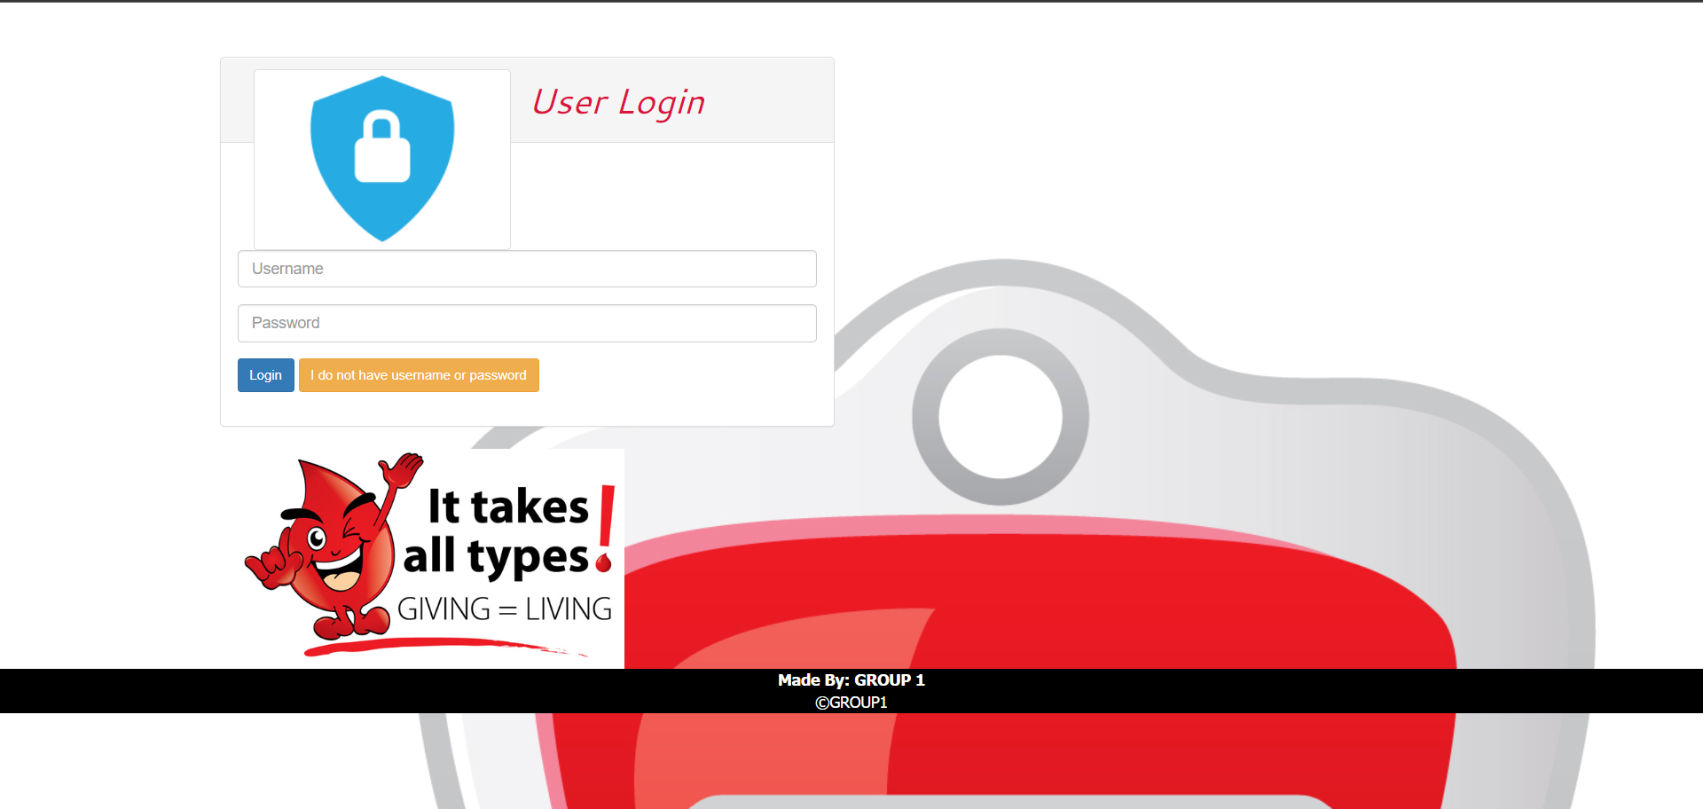
Front End
Login Page:

Slide 3
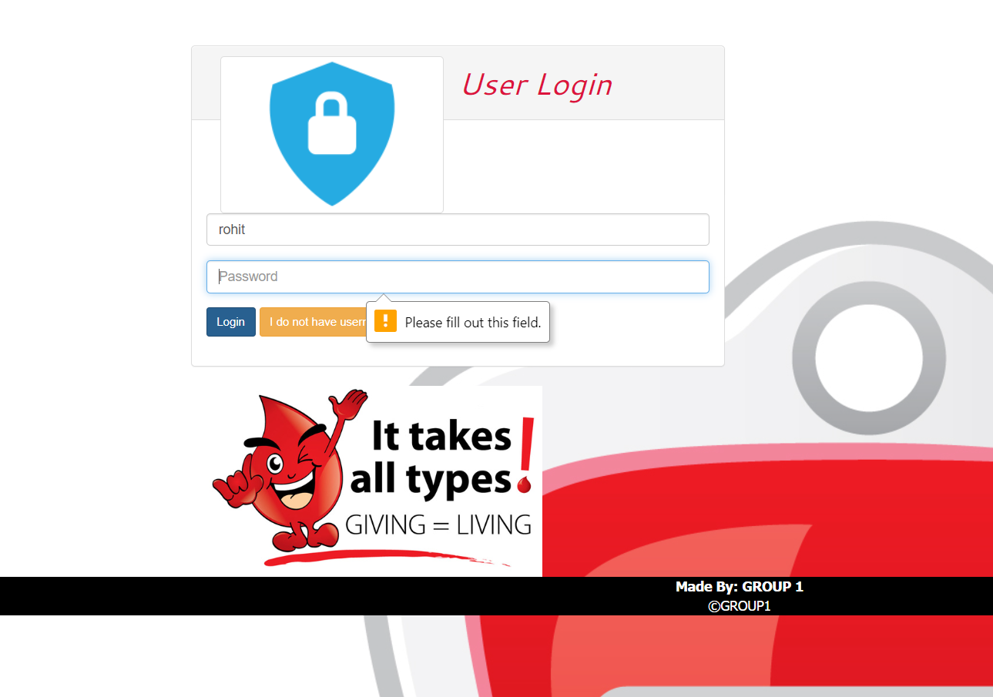

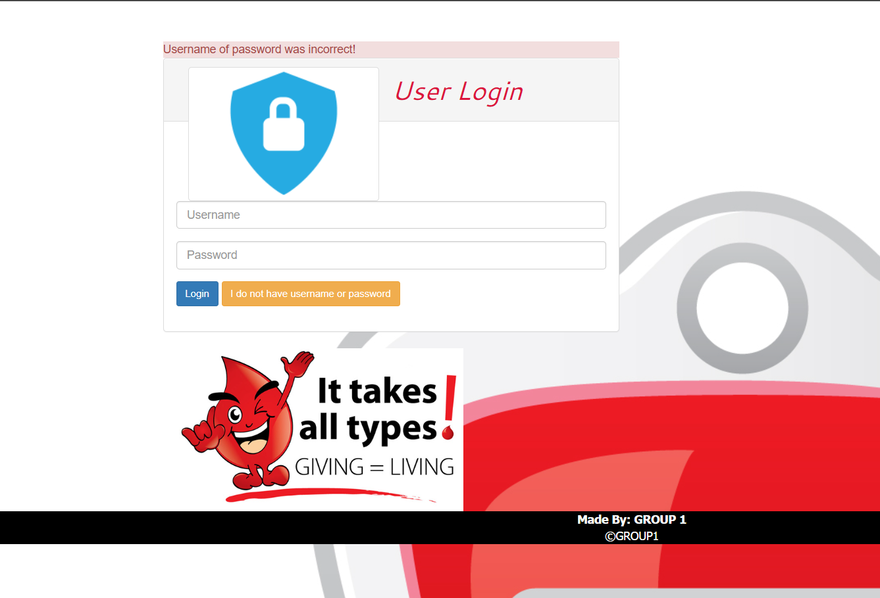
Errors In Login Page:

Slide 4
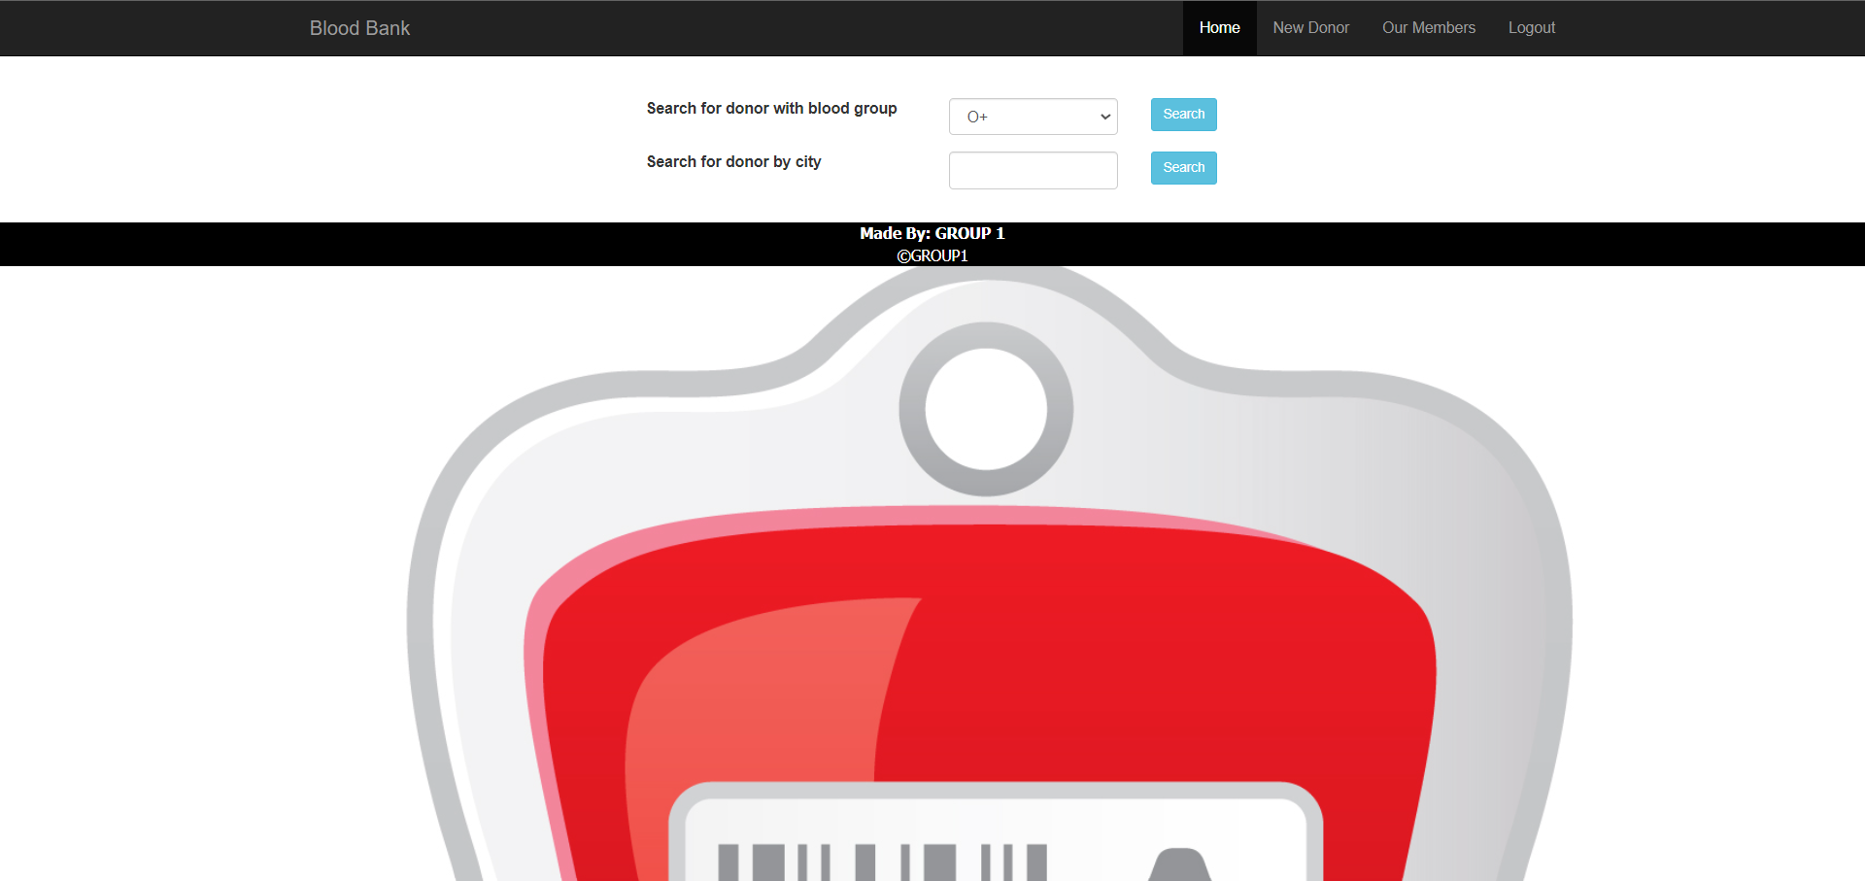
After Login:

Slide 5
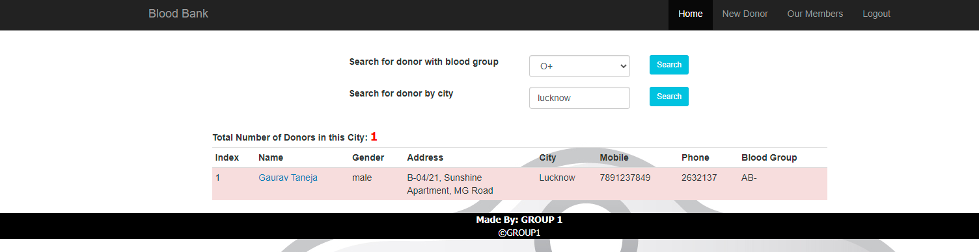
Searching blood:
By City :

Slide 6
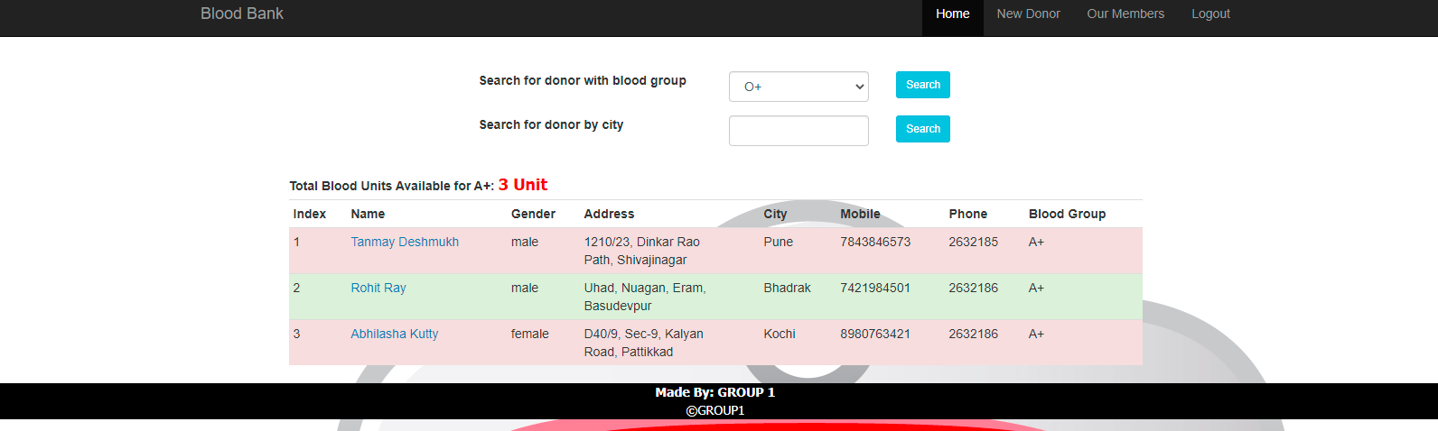
Searching blood:
By blood group :

Slide 7
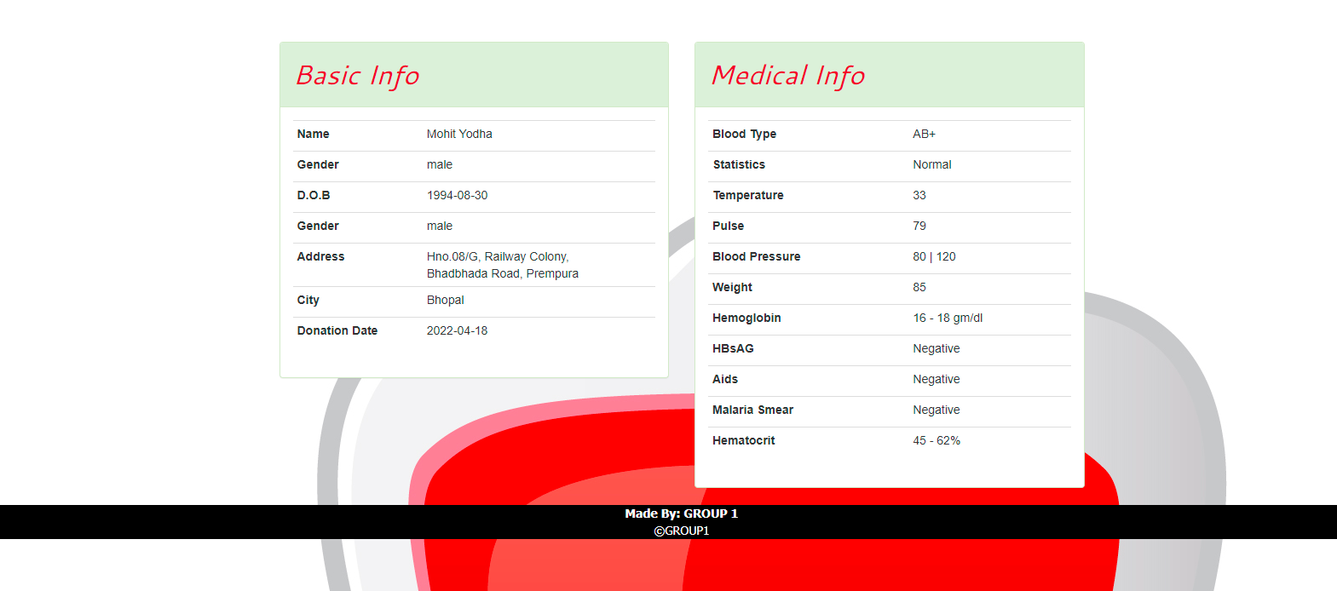
Donor’s info after chosen :

Slide 8
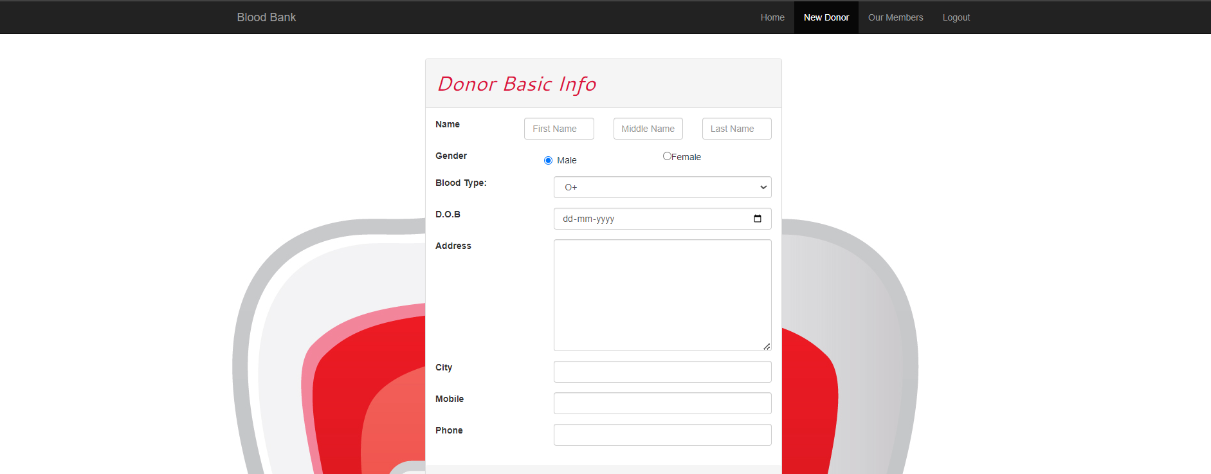
For New Donors
Donor’s Basic Info :

Slide 9
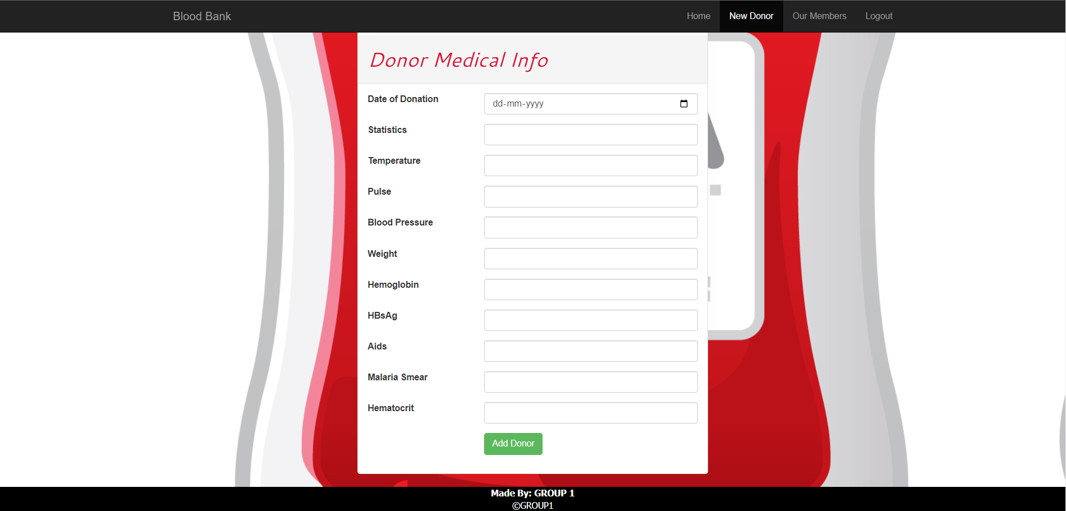
Donor’s Medical Info :

Slide 10
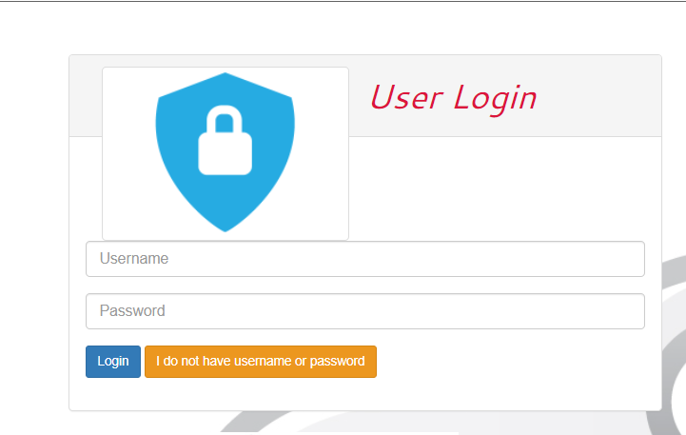
To Be a member

Slide 11
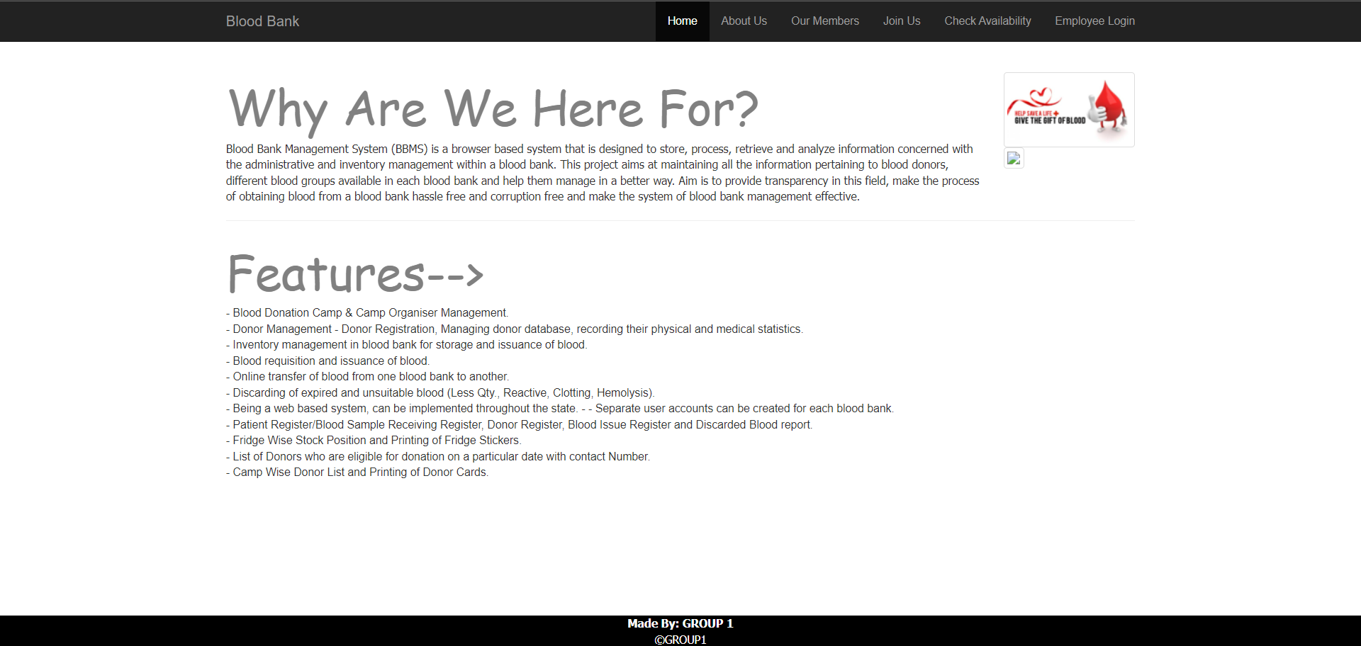
Details To Join :

Slide 12
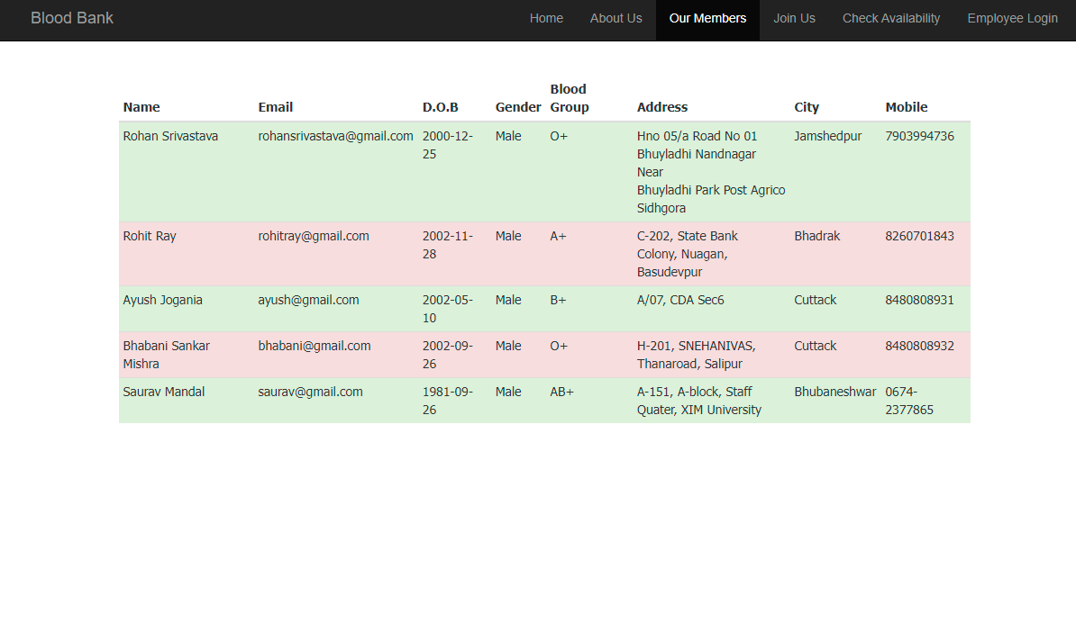
Our Members :

Slide 13
To Join us :

Slide 14
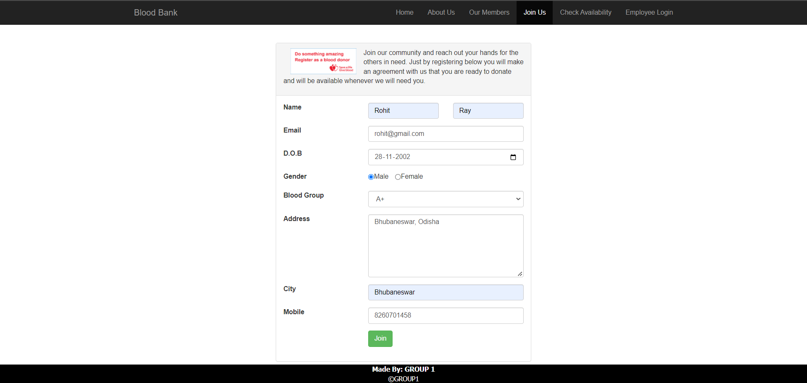
Filling The Details :

Slide 15
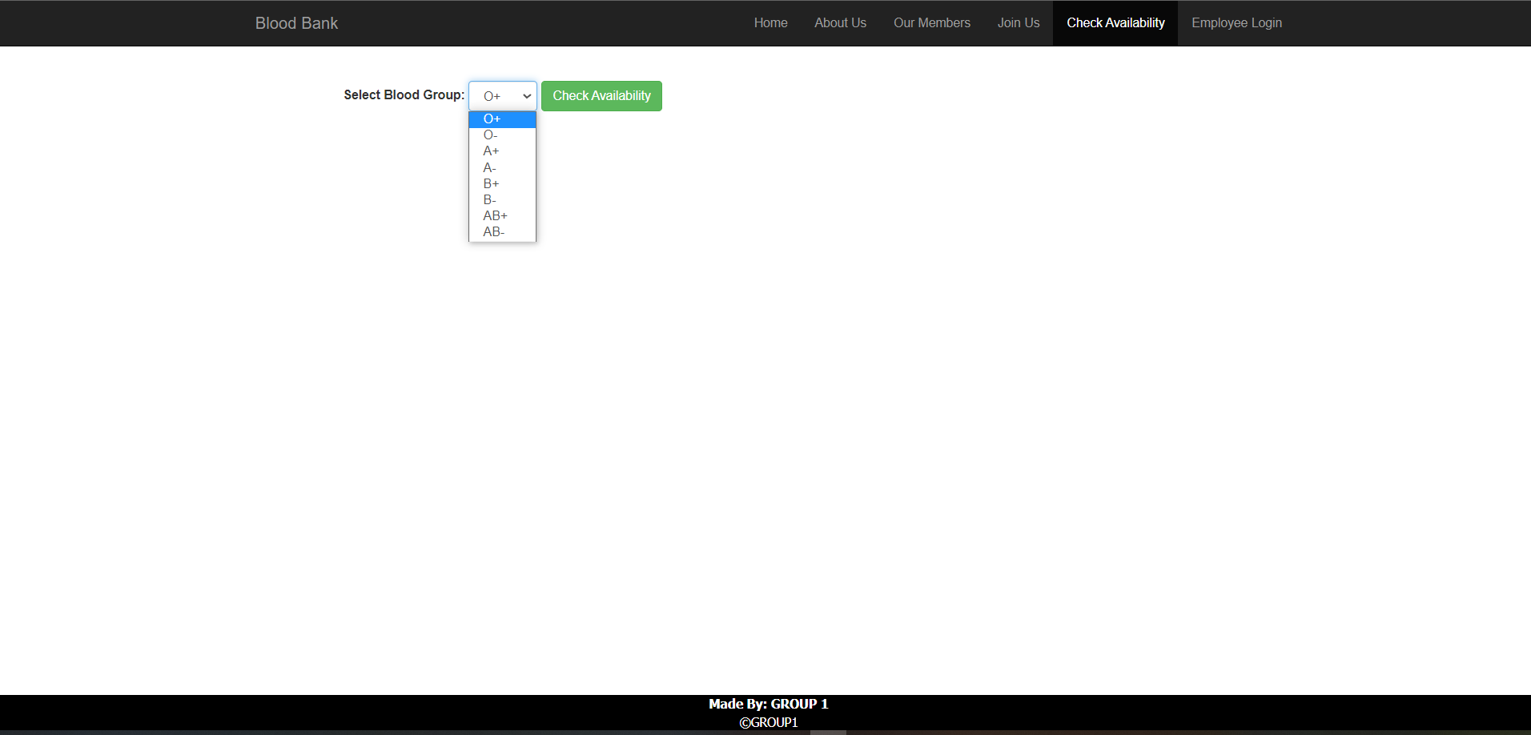
Option for Checking Availability :

Slide 16
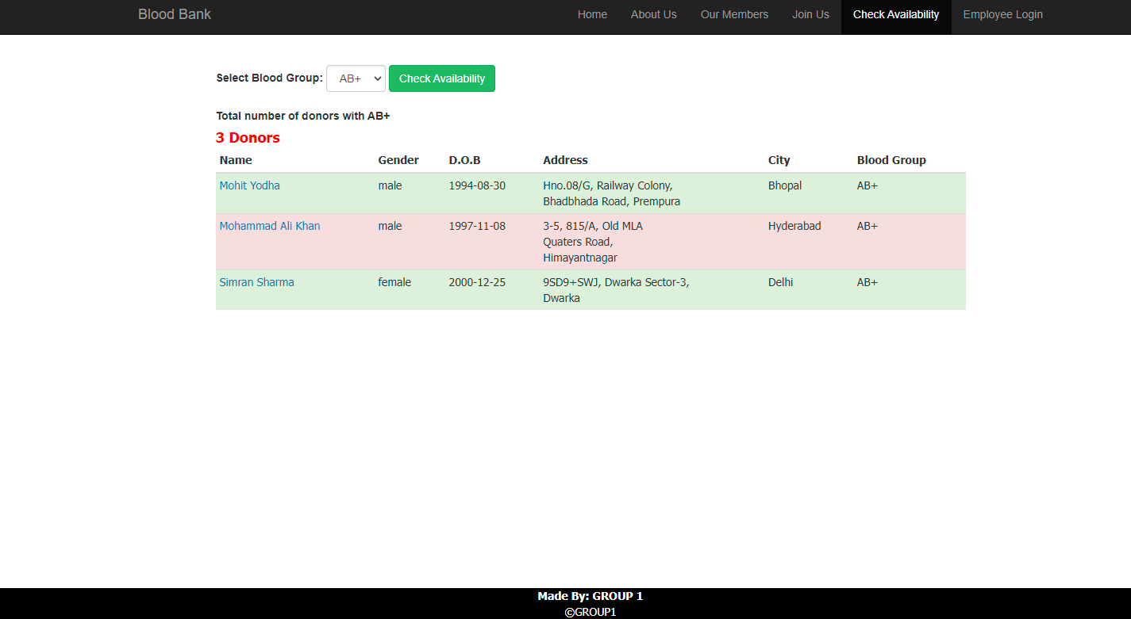
Example of Available Donors :

Slide 17
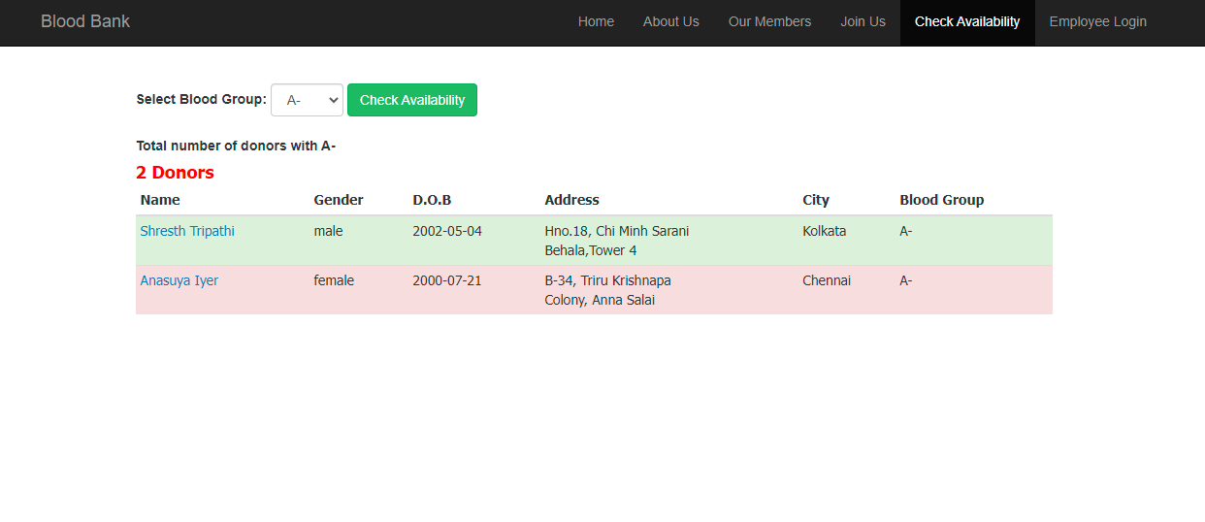
Example of Showing Results :

Slide 18
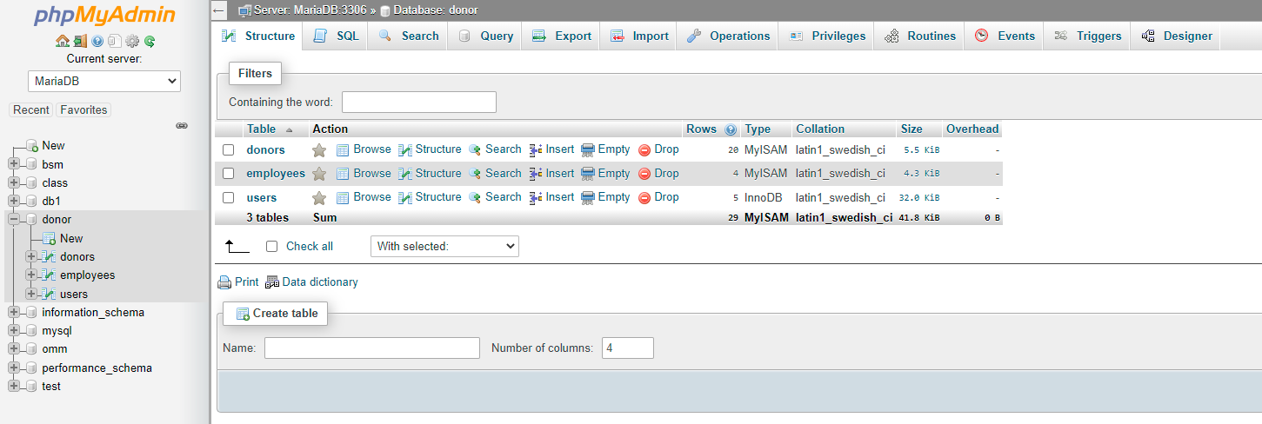
Backend
Creating a Database and inserting tables :
Database Name- donor

Slide 19
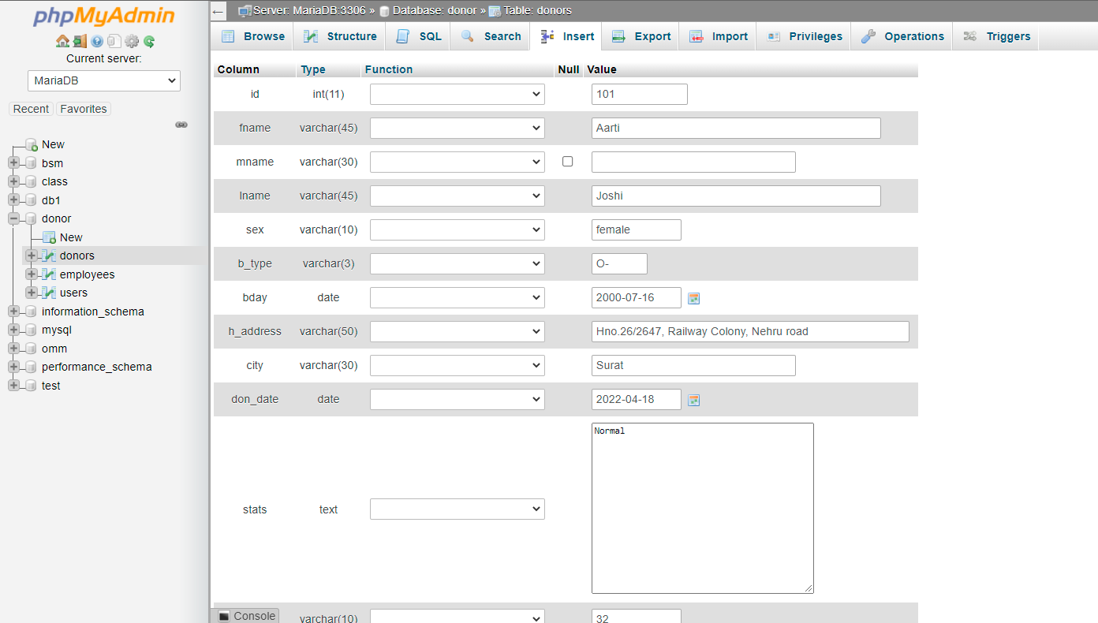
Input Data in donors table :

Slide 20
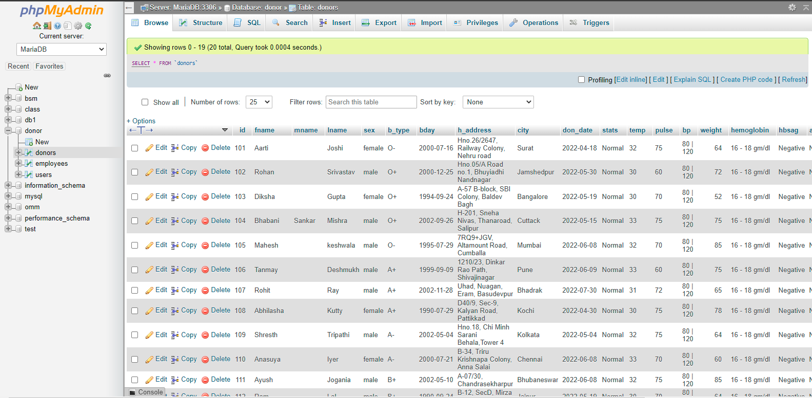
Showing all data of the donors table :

Slide 21
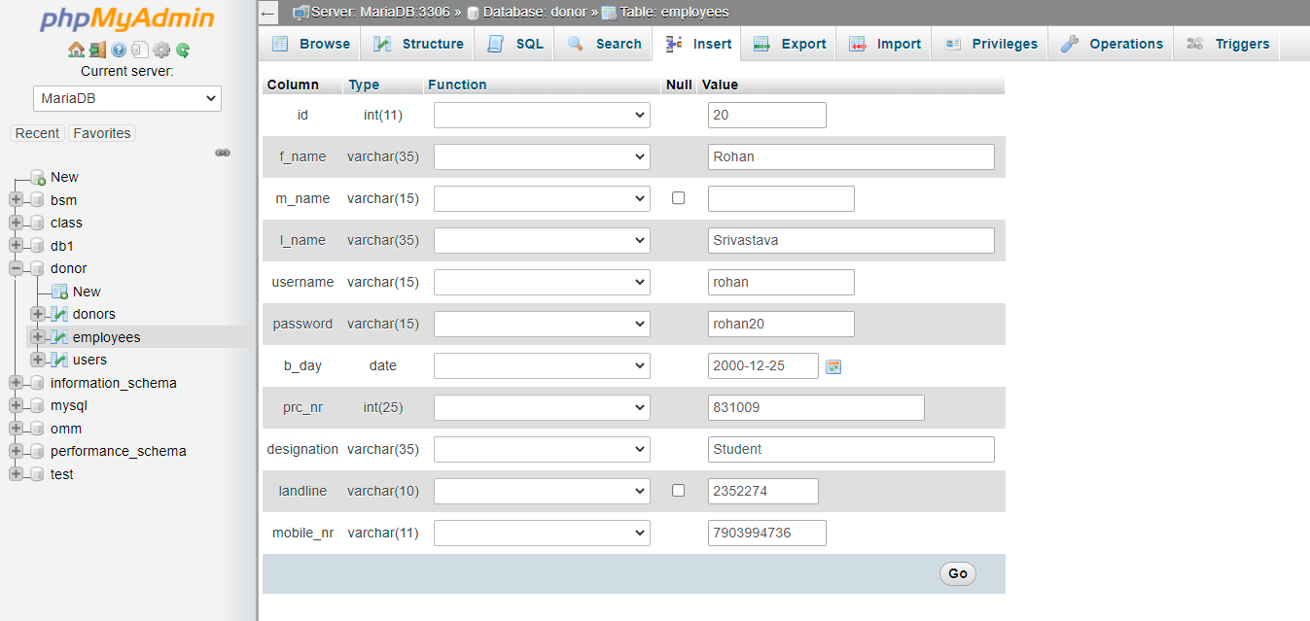
Input Data in employees table :

Slide 22
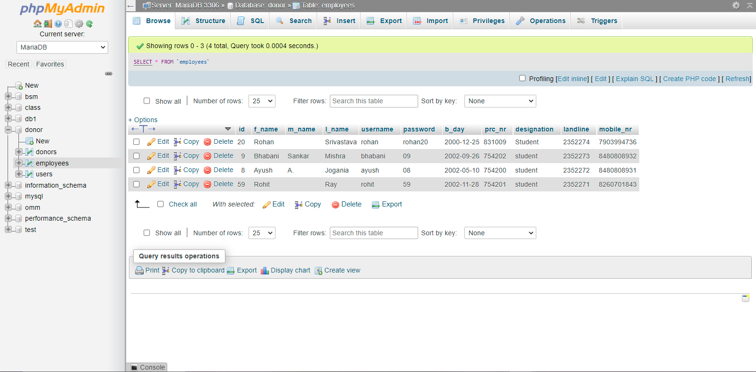
Showing all data of the employees table :

Slide 23
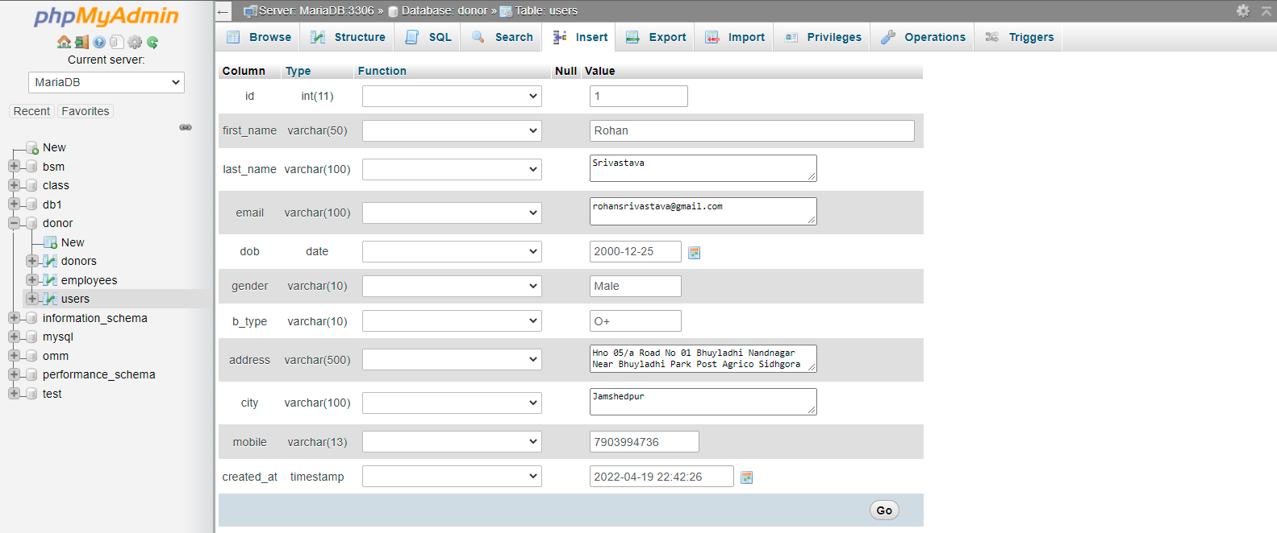
Input Data in users table :

Slide 24
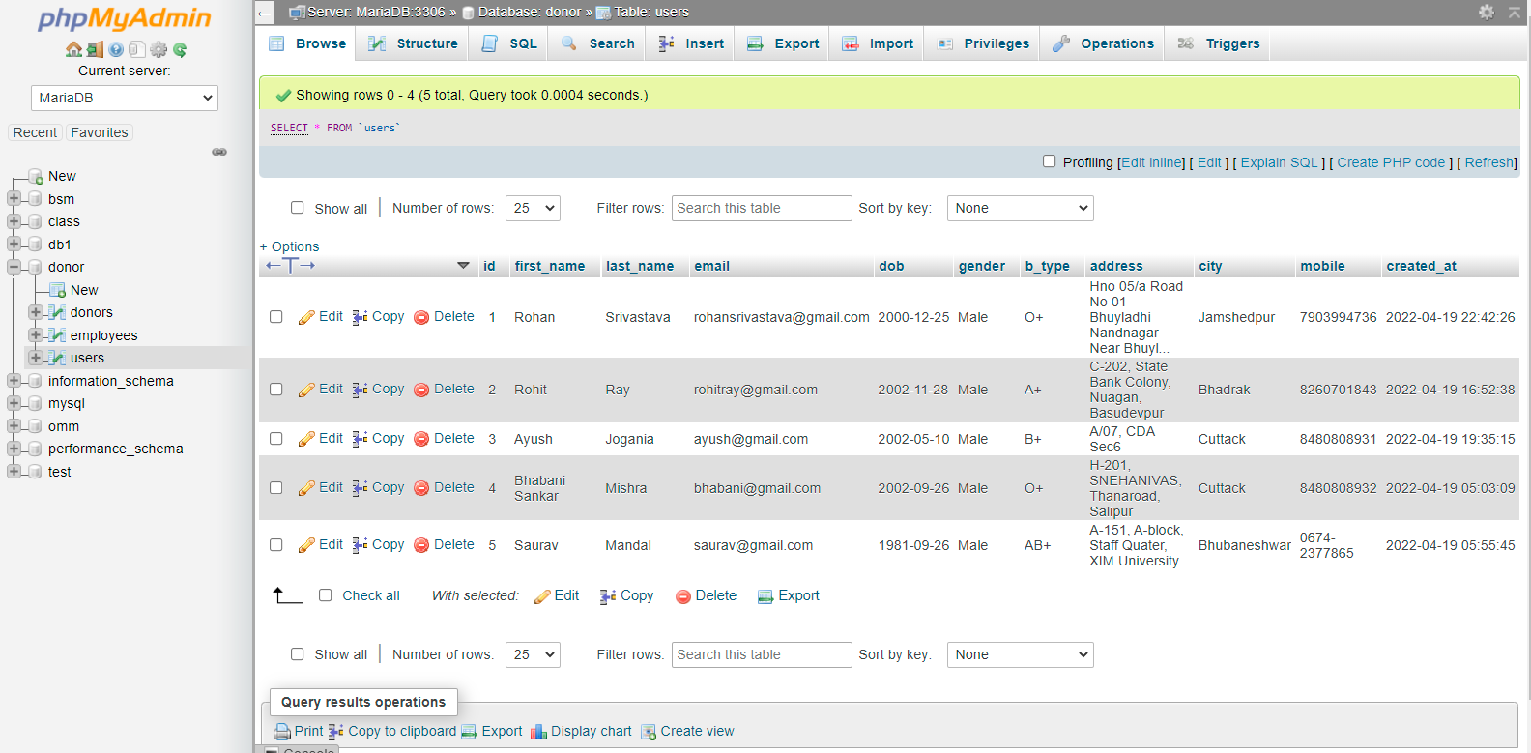
Showing all data of the users table :

